Slide 1
Final Year Project Proposal

Slide 2
CONTENTS
Introduction
Example Apps
Summary

Slide 3
INTRODUCTION

Slide 4

CM3050 Mobile Development
PROJECT IDEA TITLE 1: Task manager mobile app
To develop, test and deliver an Android app to the Google Play Store
Not developed for Apple devices, as I do not own Apple devices

Slide 5

THE IDEA FOR THIS PROJECT
Personal Experience
Downloaded task manager apps in the past, but:
Never used them consistently
App was not engaging enough
Aesthetically unappealing

Slide 6
EXAMPLE apps

Slide 7
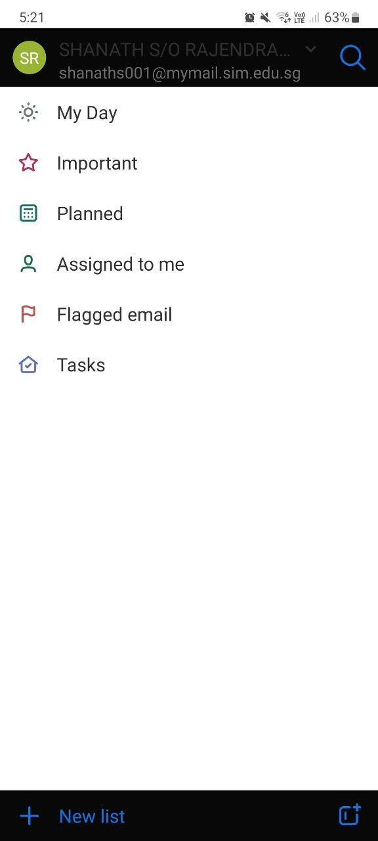
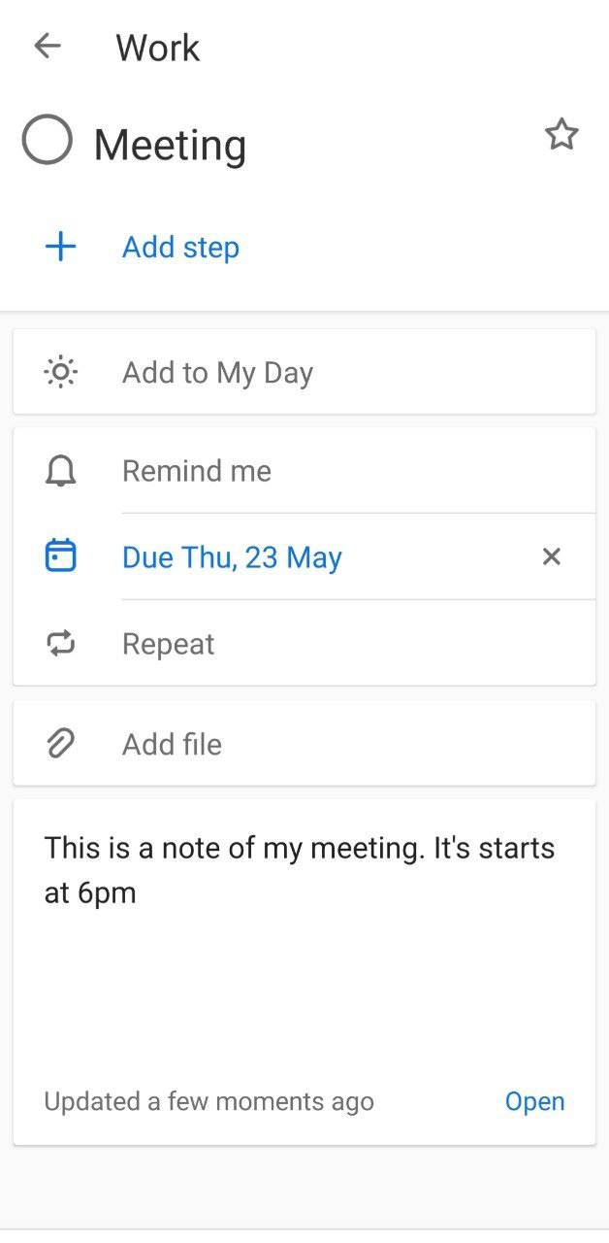
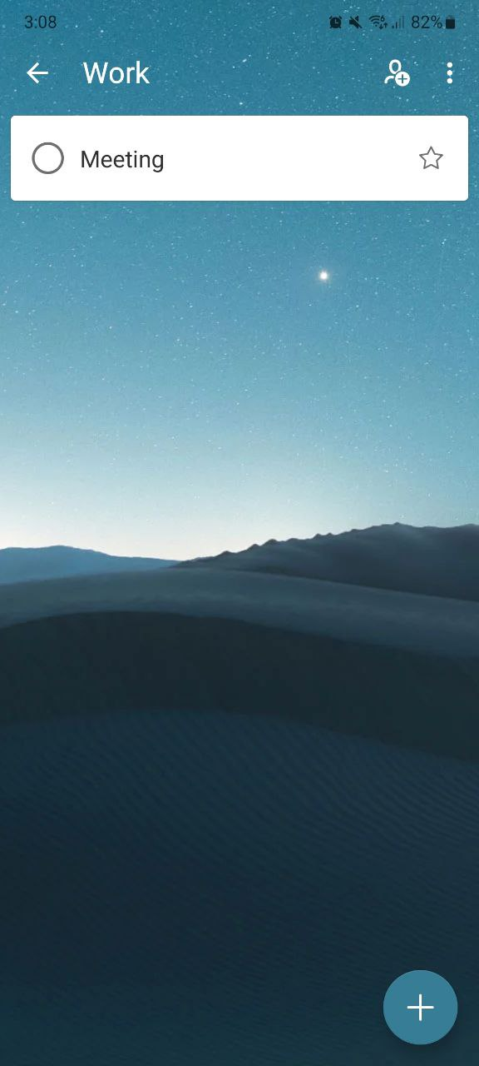
MICROSOFT TO DO
CRITICAL evaluation
Forces you to sign in to use the app
Main page has a corporate feel to it
No tutorial upon app launch
No tool to aid in focus
No tool for projects
Allows the use of images for customization
MAIN
LIST
❌
❌
❌
❌
❌
✅

Slide 8
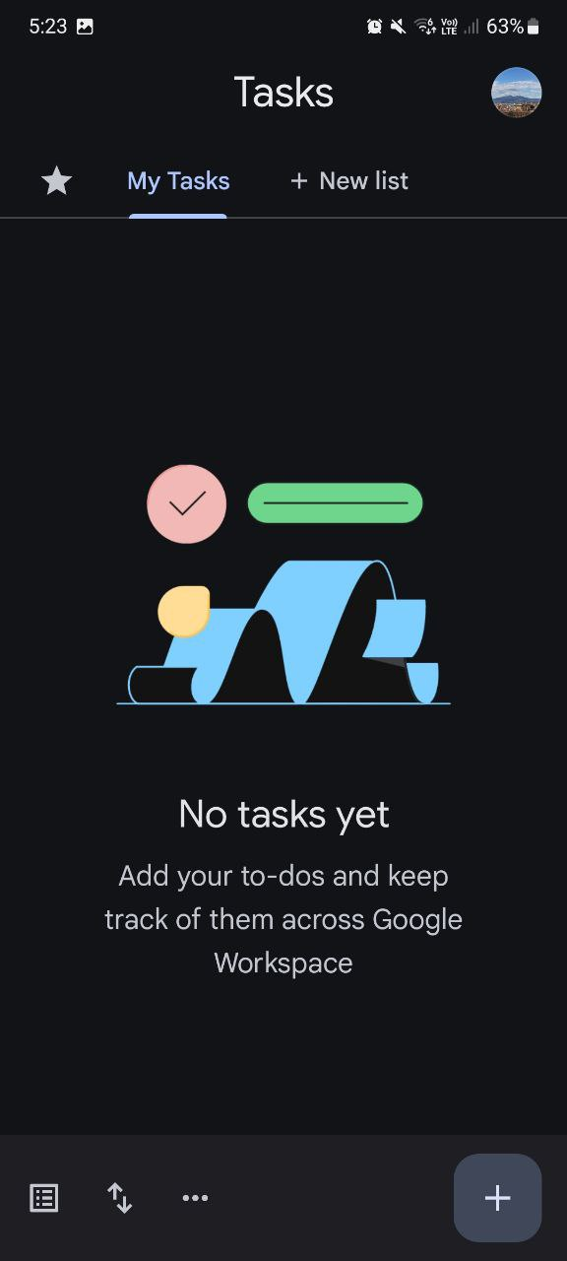
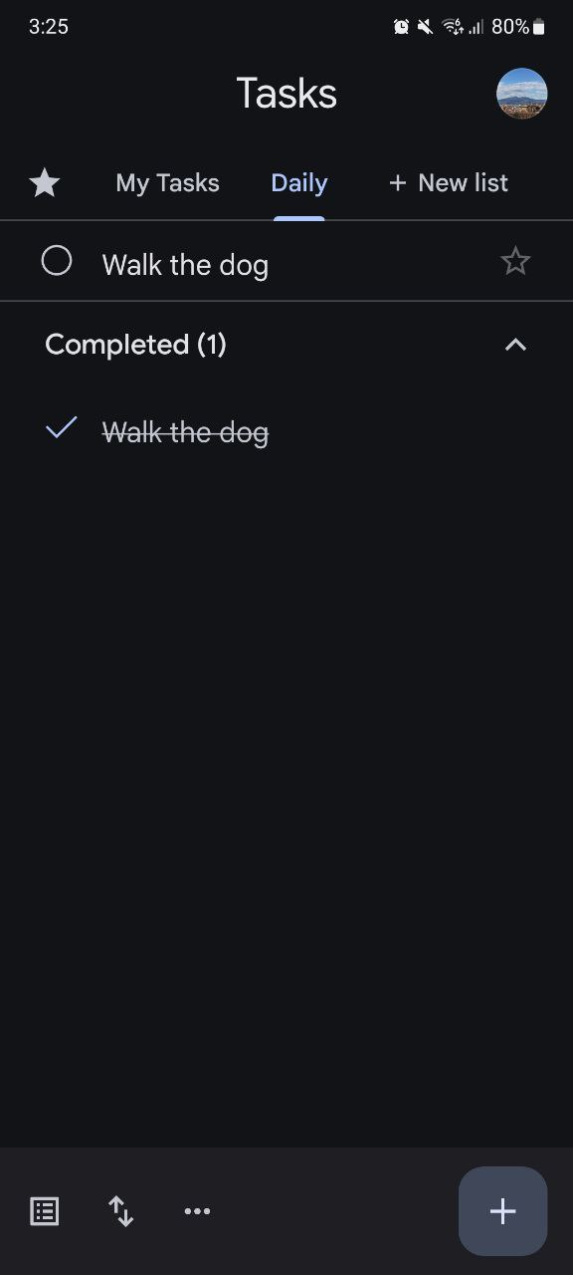
GOOGLE TASKS
CRITICAL evaluation
No tutorial upon app launch
No tool to aid in focus
No tool for projects
Minimalist feel
MAIN
LIST
❌
❌
❌
✅

Slide 9
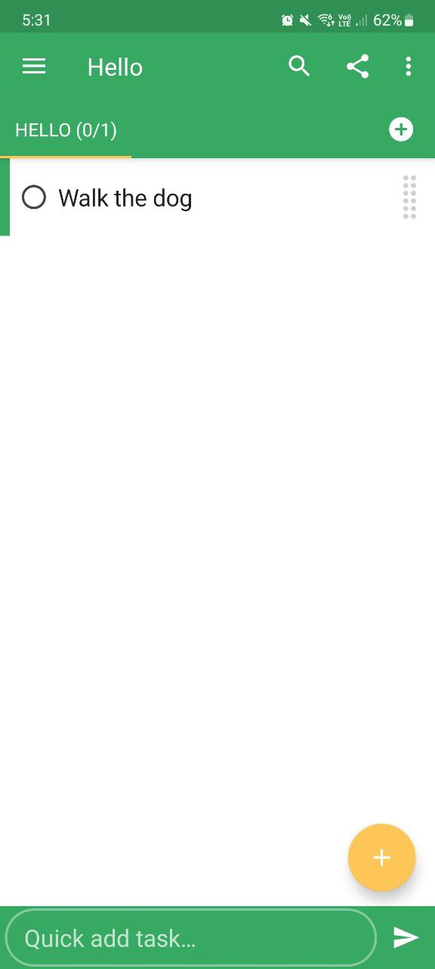
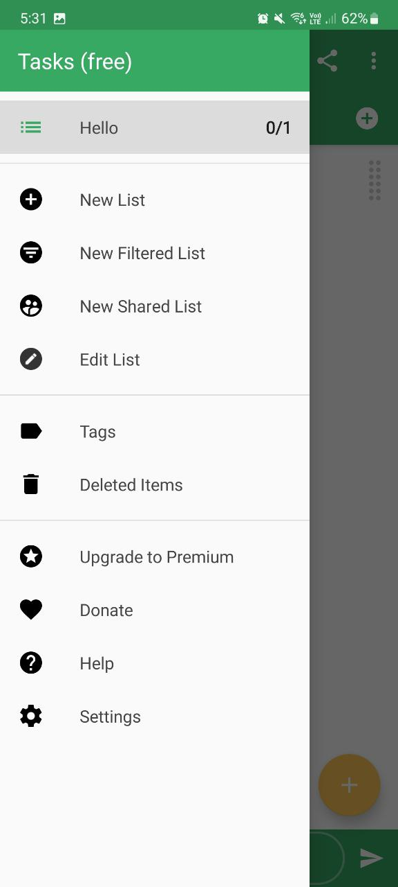
Tasks by pocket brilliance limited
CRITICAL evaluation
Poor tutorial, does not trigger upon app launch
No tool to aid in focus
No tool for projects
Color customization
MAIN
LIST
❌
❌
❌
✅

Slide 10

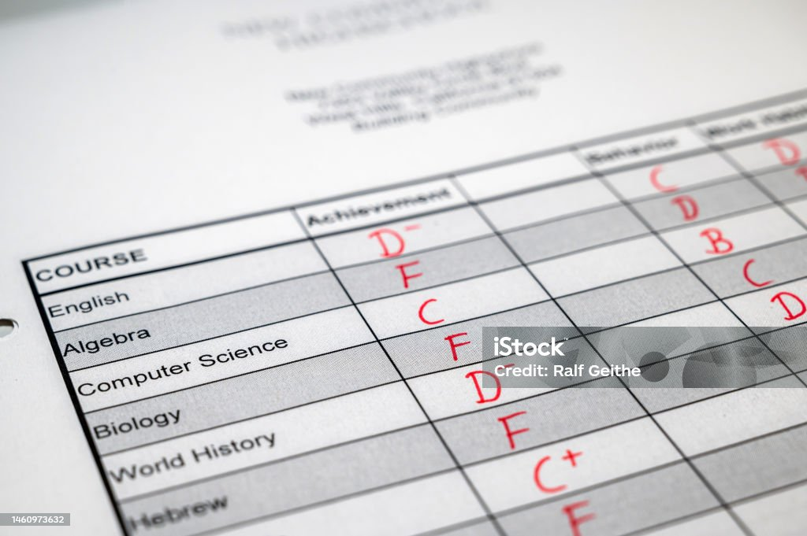
Our digital world is distracting!
College Students are distracted by digital devices (Wang, C.-H., Salisbury-Glennon, J.D., Dai, Y., Lee, S. and Dong, J. 2022).
One study found a negative associate between Facebook use and GPA (Kirschner & Karpinski,2010)
Students that don’t learn well ⬄ Students that don’t perform well

Slide 11


Too many responsibilities for adults!
A study done by the U.S. Department of Labor showed that
78% of the population, spent their days engaged in household activities
44% of the population were engaged in work/work related activities.
PER DAY!
https://www.bls.gov/news.release/pdf/atus.pdf

Slide 12
INCORPORATES THE 52-17 TECHNIQUE FOR STUDENTS
What is 52-17 rule?
52 minutes work
17 minutes rest
IF A TASK IS TOO INTENSIVE, WE NEED A BREAK!
(Albulescu, P., Macsinga, I., Rusu, A., Sulea, C., Bodnaru, A. and Tulbure, B.T. 2022)‌

Slide 13
INCORPORATES A PROJECT TAB FOR ADULTS
GOAL SETTING → POSITIVE MINDSET
BA, M.R.C. (2019). The Science & Psychology Of Goal-Setting 101
UNDERTAKE A PROJECT
SET MILESTONES
VISUALIZE MILESTONES
NOTES
CHECKLIST
Gives a measure of progress.
(Hurn, Kneebone and Cropley, 2006)

Slide 14
SUMMARY

Slide 15
takeaways
Deploying an Android app, for students and young adults
52-17 timer tab
Project management tabs
Good practices
Bad practices
Allow users to customize the app via
Colors and images
Having a tutorial
Guides the users on all features
Forcing users to sign in to use the app
Poor UI/UX

Slide 16
THANK YOU
Shanath S/O Rajendran
UoL ID : 210470552
shanaths001@mymail.sim.edu.sg

